Slide 1
Lecture 4: Theory of spatial models
April 19, 2015

Slide 2
Why deal with space?
All processes have an underlying spatial domain to them.
Many of our observations contain spatial data (whether we chose to use it or not)
Gain a richer understanding of the dynamics by explicitly incorporating spatial dynamics and spatial autocorrelation

Slide 3
Why should we fit models that incorporate spatial autocorrelation?
Failure to incorporate the spatial autocorrelation may lead to incorrect inference on the factors that describe the mean portion of the model.
For example – what if have an animal that likes to group?
Some occupied habitat may be due to high quality habitat and some marginal habitat may be occupied to be close to other conspecifics. Failure to take the spatial correlation into account will lead to assuming that the marginal habitat is high quality.
How might this play out for a territorial species?
Notes:
Territorial species – good habitat may gradient or depend on the fitness of the individual

Slide 4
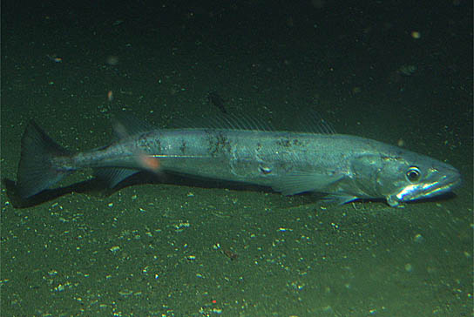
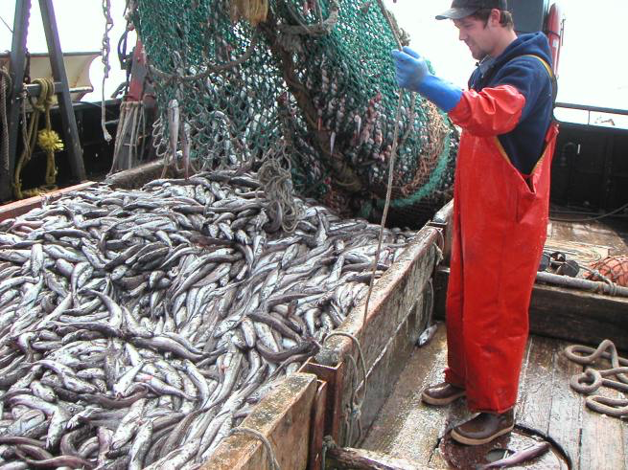
Case Study
Agostini et al. 2008. Climate–ocean variability and Pacific hake: A geostatistical modeling approach. J of Marine Systems, 71:237-248.
credit: sanc1717
credit: Rodney Johnson

Slide 5
Objective
Determine environmental factors describing hake habitat while accounting for spatial autocorrelation (hake are a schooling fish so may expect spatial autocorrelation)

Slide 6
Approach
Fit Generalized Linear Models with spatial autocorrelation (notation of Agostini et al. 2008)
where
μ_{i} is a mean process affecting the role of habitat and is a function of covariates C_{i} (depth and current) via μ_{i}=C_{i}β
x_{i} is the observation location
S(x_{i}) is a stationary Gaussian process with expected value E[S(x)] = 0 and cov[S(x_{i}),S(x_{j})] = σ²ρ(x_{i} – x_{j}) where σ²=variance and ρ = correlation coefficient)
ε_{i} are mutually independent with variance = v²
Notes:
Should always have an intercept in your model when you have a spatial process

Slide 7
Modeling spatial autocorrelation
Used an exponential variogram to model the spatial autocorrelation S(x) (more on this later in the lecture)
where τ² is the small scale variability at small distances (nugget), ϕ is the distance over which samples are autocorrelated (range), and σ² is the background variability (sill)
Model S(x) simultaneously with estimating β coefficients
Use GeoR package in R

Slide 8
Results
Without spatial autocorrelation AIC = 7057
With spatial autocorrelation AIC = 6014
Without spatial autocorrelation
With spatial autocorrelation

Slide 9
Topics
Geostatistical processes
Generalized covariance matrix for state process
Variogram functions
Stationarity, isotropy, anisotropy
Test of spatial independence – Moran’s I
Geostatistical modeling

Slide 10
Definitions -
Spatial series-
Z_{s} is a noisy observation of a process at location s with expected value μ_{s}
μ_{s} is a function of covariates X_{s} and random effects ε_{s,} the random effects may contain spatial autocorrelation and we want to model this appropriately

Slide 11
Stationarity
Strong stationarity: spatial model for C_{s} is stationary if all statistics remain unchanged after spatial shifts, i.e. remain unchanged for all C_{s+h} for all possible h (all moments are invariant)
Weak stationarity: spatial model for C_{s} is stationary if the mean function is constant and auto-covariance is a function of distance (only mean and variance are invariant)

Slide 12
Spatial covariance functions
Distance between sites in 2 (or more) dimensions can be calculated with the Euclidean norm
Covariance C_{Y} is defined as a function of the distance ||h|| between sites, for example the exponential covariance function, where I() is the indicator function that equals 1 if the condition is TRUE
Notes:
Network distance as opposed to overland distance
e.g. river systems, valleys, etc.

Slide 13
Examples of covariance functions

Slide 14
If instead, we define a variance function (the covariogram) that is the variance of the differences in observations at 2 locations, Z_{i} and Z_{j}
If the process is second order stationary, then then E(Z) = 0, and var(Z_{i} ) = var(Z_{j}) = C(0), where C(0) is the covariance at distance 0
Notes:
Covariance at lag of zero = variance at that specific location

Slide 15
Variogram
The covariogram or variogram is
Half this quantity is the semivariogram
Nugget
Sill is the variance at large h, sill = C(0), partial sill = C(0) – c₀
Range = min r where γ(r(1+e))=C(0) = sill
Notes:
Covariance at lag of 0 - covariance at lags larger than 0

Slide 16
Variogram components
sill
range
nugget
Notes:
Sill – variability at large distances
Range – variability at medium distances, can be drastic changes relating to the distance from point
Nugget – amount of variability you have at small spatial scales, measurement error, or scale finer-than-measureable
TMB going to work with covariance matrix, not semivariagram or covariagram → these are terms in geostatistics
Nugget – process and measurement error
In geostatistics – probability of going back to the exact same site is 0
Never have a perfect resample where the sill occurs → nugget interpreted as the measurement error

Slide 17
The functional forms of the semivariogram γ(h) are related to the covariance functions, for example the exponential semivariogram is:
where I() is the indicator function that equals 1 if the condition is TRUE
Notes:
Theta1 is the range – over what spatial lags do we see spatial autocorrelation
Estimate theta1 and variances

Slide 18
Examples of variogram functions

Slide 19
Isotropy and Anisotropy
If the spatial covariance structure is equivalent in all directions, it can be described as a function of distance only and is said to be isotropic
If instead, the covariance structure varies in different directions, then it is a function of the distance and direction and is said to be anisotropic
We must deal with anisotropy either by transforming or by constructing variograms for different directions
Notes:
Hierarchical model – probability models
Probability of data
Probability of random effects
Prefer to only talk about mean and variance, probability distributions, instead of variograms and semivariograms
Sill, nugget, and range- will end up estimating analogous parameters

Slide 20
Estimating spatial autocorrelation
Two-step process:
Remove all trend so that have a mean 0 process
Evaluate spatial autocorrelation in residuals with Moran’s I
Calculate empirical semivariogram
Classic estimator
Robust estimator
Fit theoretical variogram to empirical semivariogram
Obtain estimates of nugget, range, and sill
One-step process:
Estimate trend and spatial covariance parameters simultaneously

Slide 21
Test of spatial autocorrelation
Need a test of whether spatial autocorrelation is likely
Moran’s I
where N is the number of spatial units indexed by i and j and X is the variable of interest; and w is an element of a matrix of spatial weights.
The expected value of Moran's I under the null hypothesis of no spatial autocorrelation is
Implemented in R packages spdep and ape

Slide 22
Spatial data – we will start with a simulated, 2nd order stationary data series

Slide 23
Empirical variogram
Classic variogram
where z is a datum at a particular location, h is the distance between ordered data, and n(h) is the number of paired data at a distance of h
Modulus or robust variogram (Cressie 1993)
Notes:
Distance bins are not independent – resampling data many times to come up with distance bins
Least squares, maximum likelihood
n(h) – range – central plus a tolerance

Slide 24
Variogram clouds

Slide 25
Binned variogram clouds
Notes:
Technique used to estimate variance parameters (sill, nugget, and range)
Then assume these parameters are known without errors, do second estimation stage that gives you your map
At this point, just data exploration

Slide 26
Empirical variogram

Slide 27
Fitting theoretical to empirical variogram

Slide 28
Kriging - spatial prediction

Slide 29
Simulating spatially autocorrelated data

Slide 30
Simulation methods
Choleski Decomposition - decompose Σ using two triangular matrices L and L’, use L to create correlated random effects from iid random variables e
RandomFields - simulation of stationary and isotropic random fields including circulant embedding, turning bands, and decomposition methods
Notes:
Dimensions of covariance matrix – sites

Slide 31
Extensions:
Anisotropy – variograms in multiple directions
Ordinary Kriging
Simple Kriging
Universal Kriging - fitting a model for the trend and a model for the variogram or covariance for the spatial autocorrelation
Cokriging – fitting models for multivariate data
Notes:
Ordinary – trend
Simple – no trend
You tend to find gold where you find iron ore – cheap to look for iron, use spatial maps for where you find iron to predict where you may find gold
Kriging or Gaussian process regression is a method of interpolation for which the interpolated values are modeled by a Gaussian process governed by prior covariances, as opposed to a piecewise-polynomial spline chosen to optimize smoothness of the fitted values.

Slide 32
Some R packages for geostatistical modeling
fields
geoR
geoRGLM
gstat
Rgeostats
Spatial
spdep
RandomFields

